Slide 1


Slide 2
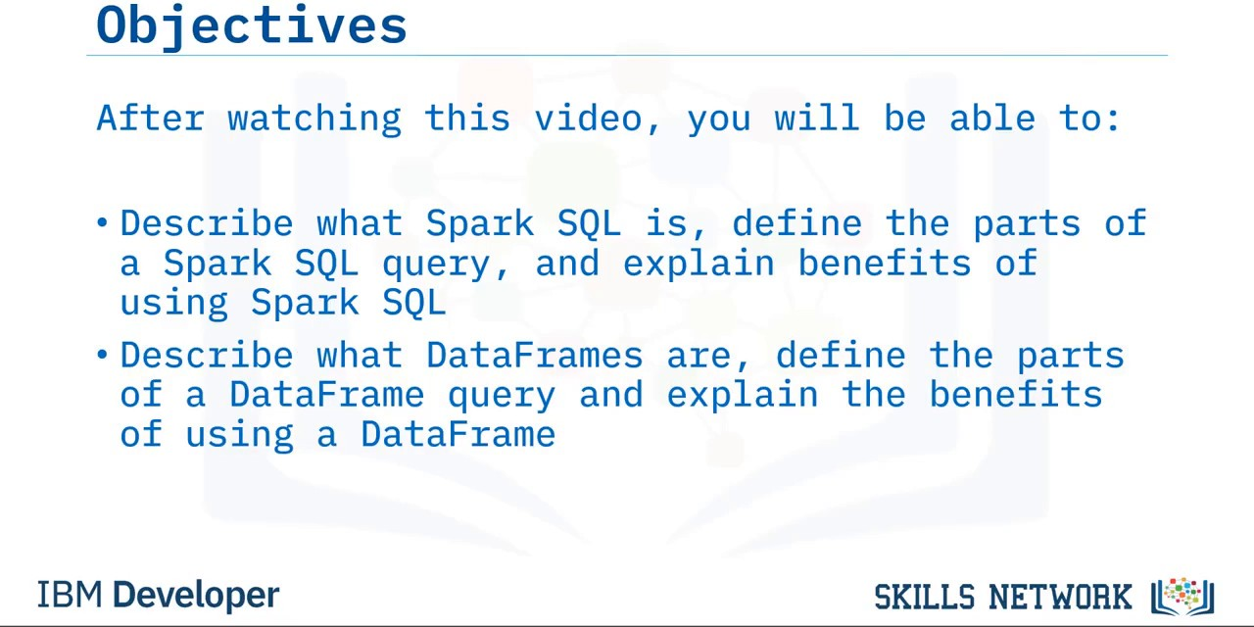

Slide 3
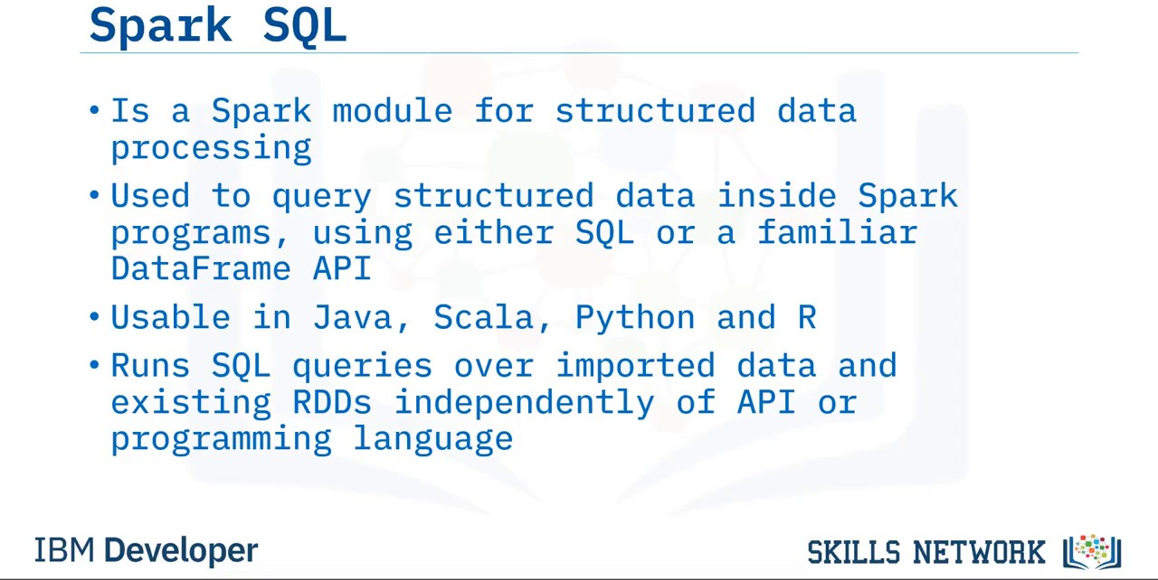

Slide 4
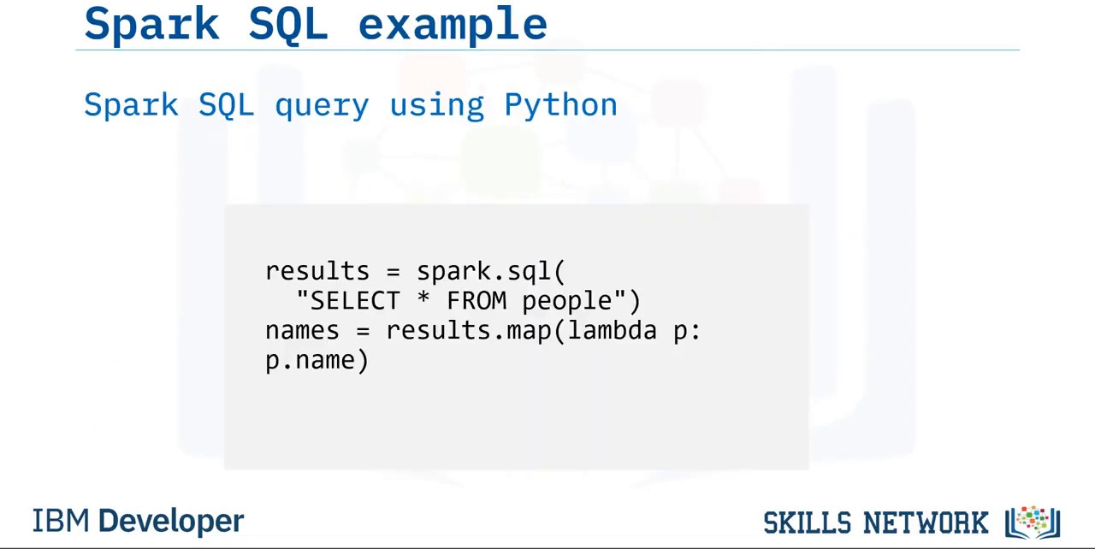

Slide 5
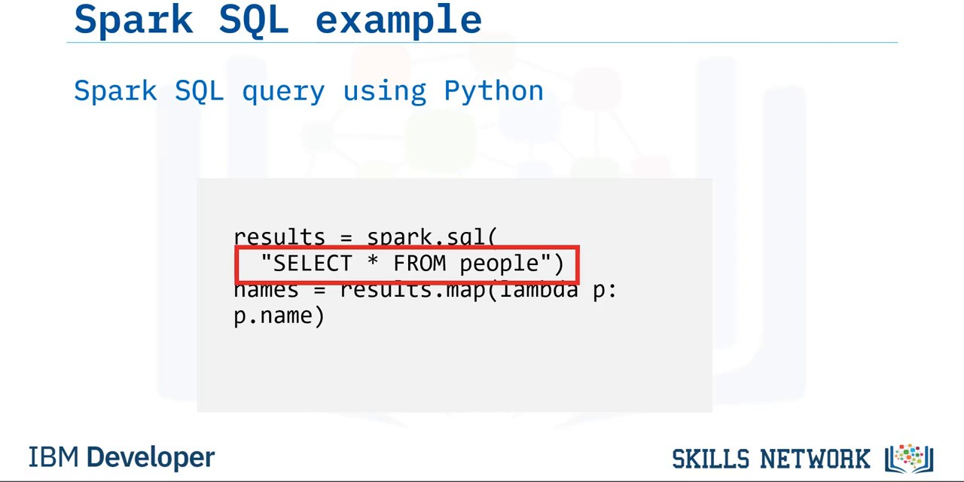

Slide 6
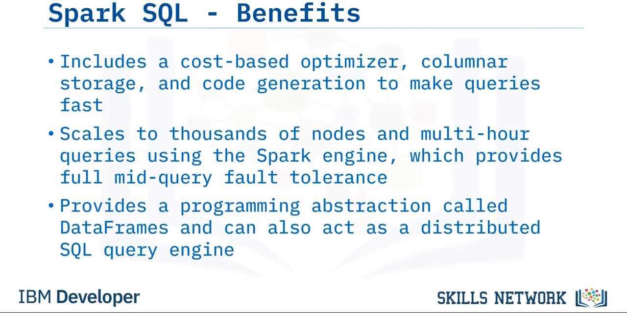

Slide 7
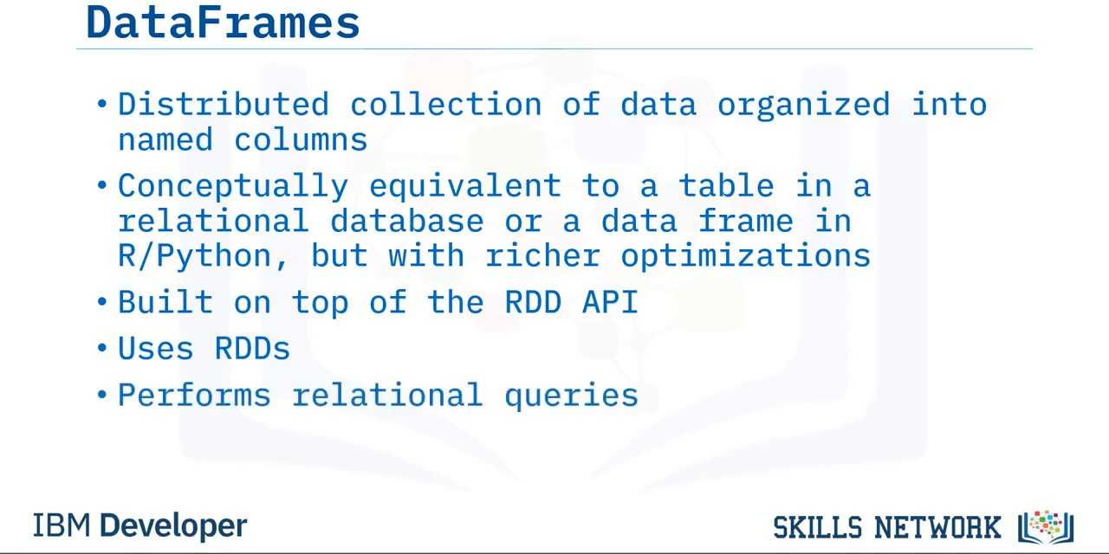

Slide 8
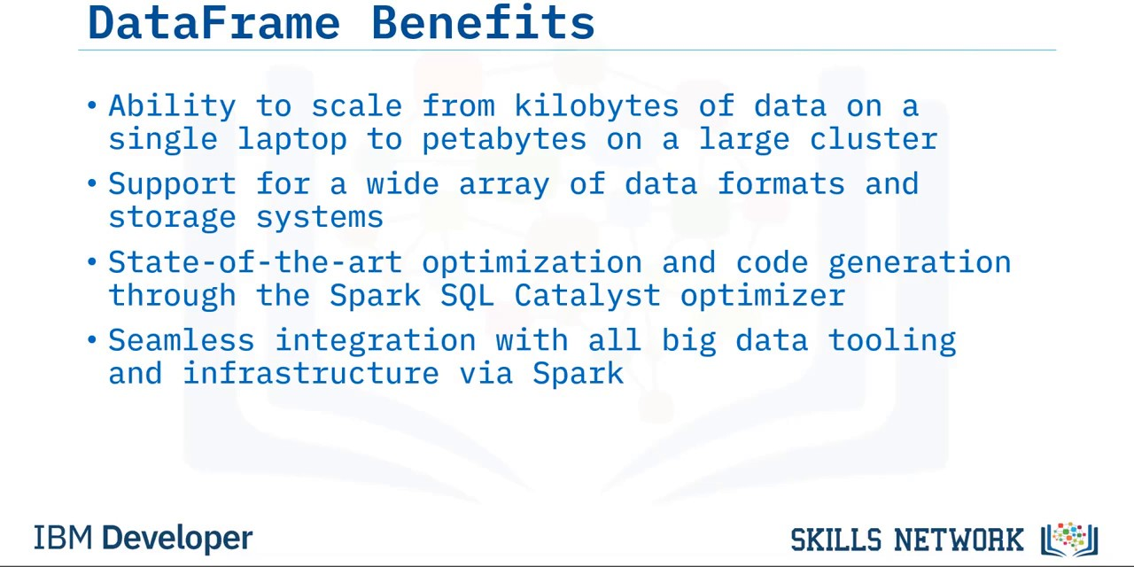

Slide 9
Create a DataFrame from reading a CSV/JSON/TXT
df_csv = spark.read.csv("people.csv", header=True, inferSchema=True)
df_json = spark.read.json("people.json", header=True, inferSchema=True) df_txt = spark.read.txt("people.txt", header=True, inferSchema=True)
Path to the file and two optional parameters Two optional parameters
header=True , inferSchema=True

Slide 10
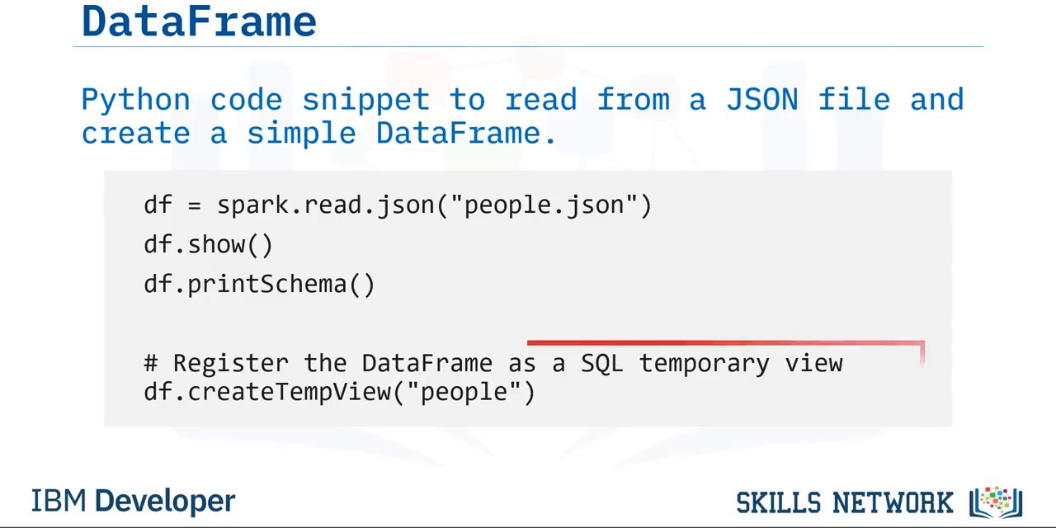

Slide 11
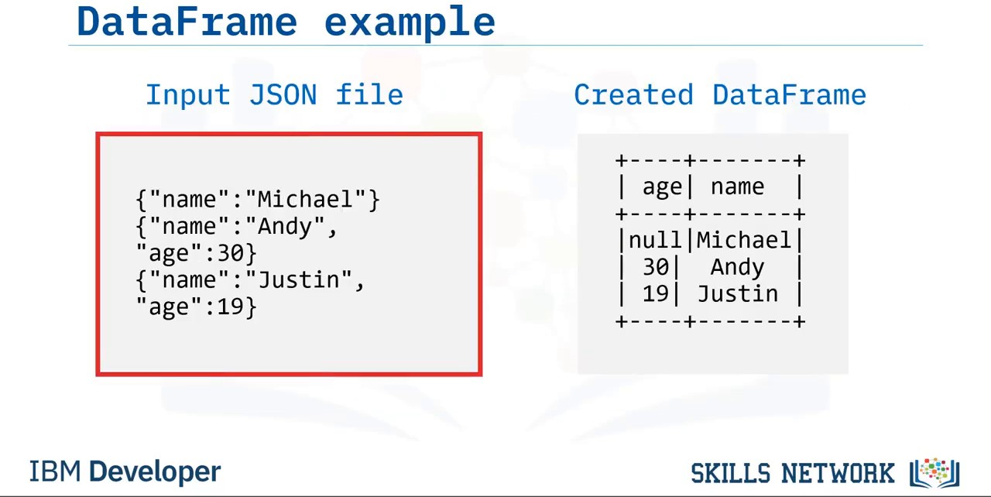

Slide 12
Create a DataFrame from RDD
iphones_RDD = sc.parallelize([ ("XS", 2018, 5.65, 2.79, 6.24),
("XR", 2018, 5.94, 2.98, 6.84),
("X10", 2017, 5.65, 2.79, 6.13),
("8Plus", 2017, 6.23, 3.07, 7.12)
])
names = ['Model', 'Year', 'Height', 'Width', 'Weight']
iphones_df = spark.createDataFrame(iphones_RDD, schema=names) type(iphones_df)
pyspark.sql.dataframe.DataFrame

Slide 13
Interacting with PySpark DataFrames
Upendra Devisety
Science Analyst, CyVerse

Slide 14
DataFrame operators in PySpark
DataFrame operations: Transformations and Actions DataFrame Transformations:
select(), filter(), groupby(), orderby(), dropDuplicates() and withColumnRenamed()
DataFrame Actions :
head(), show(), count(), columns and describe()

Slide 15
select() and show() operations
select()
transformation subsets the columns in the DataFrame
df_id_age = test.select('Age')
show()
action prints first 20 rows in the DataFrame
df_id_age.show(3)
+---+
|Age|
+---+
| 17|
| 17|
| 17|
+---+
only showing top 3 rows

Slide 16
filter() and show() operations
filter()
transformation filters out the rows based on a condition
new_df_age21 = new_df.filter(new_df.Age > 21) new_df_age21.show(3)
+ + + +
|User_ID|Gender|Age|
+ +
|1000002|
|1000003|
|1000004|
+ +
+ +
M| 55| M| 26| M| 46|
+ +
only showing top 3 rows

Slide 17
groupby() and count() operations
groupby()
operation can be used to group a variable
test_df_age_group = test_df.groupby('Age') test_df_age_group.count().show(3)
+ + +
|Age| count|
+ + +
| 26|219587|
| 17| 4|
| 55| 21504|
+ + +
only showing top 3 rows

Slide 18
orderby() Transformations
orderby()
operation sorts the DataFrame based on one or more columns
test_df_age_group.count().orderBy('Age').show(3)
+ + +
|Age|count|
+ + +
| 0|15098|
| 17| 4|
| 18|99660|
+ + +
only showing top 3 rows

Slide 19
dropDuplicates()
dropDuplicates()
removes the duplicate rows of a DataFrame
test_df_no_dup = test_df.select('User_ID','Gender', 'Age').dropDuplicates() test_df_no_dup.count()
5892

Slide 20
withColumnRenamed Transformations
withColumnRenamed()
renames a column in the DataFrame
test_df_sex = test_df.withColumnRenamed('Gender', 'Sex') test_df_sex.show(3)
+ + + +
|User_ID|Sex|Age|
+ +
|1000001|
|1000001|
|1000001|
+ +
F| 17| F| 17| F| 17|
+ + + +

Slide 21
printSchema()
printSchema()
operation prints the types of columns in the DataFrame
test_df.printSchema()
|-- User_ID: integer (nullable = true)
|-- Product_ID: string (nullable = true)
|-- Gender: string (nullable = true)
|-- Age: string (nullable = true)
|-- Occupation: integer (nullable = true)
|-- Purchase: integer (nullable = true)

Slide 22
columns actions
columns
operator prints the columns of a DataFrame
test_df.columns
['User_ID', 'Gender', 'Age']

Slide 23
describe() actions
describe()
operation compute summary statistics of numerical columns in the DataFrame
test_df.describe().show()
+ +
|summary|
+ +
+ +
User_ID|Gender|
+ +
+
Age|
+
| count|
|
550068|550068| 550068|
mean|1003028.8424013031|
null|30.382052764385495| null|11.866105189533554|
| stddev|1727.5915855307312|
|
|
+
min| max|
+
1000001|
1006040|
+
F| M|
+
0|
55|
+

Slide 24
Interacting with DataFrames using PySpark SQL

Slide 25
DataFrame API vs SQL queries
In PySpark You can interact with SparkSQL through DataFrame API and SQL queries The DataFrame API provides a programmatic domain-specific language (DSL) for data DataFrame transformations and actions are easier to construct programmatically
SQL queries can be concise and easier to understand and portable The operations on DataFrames can also be done using SQL queries

Slide 26
Executing SQL Queries
The SparkSession sql()
method executes SQL query
sql()
method takes a SQL statement as an argument and returns the result as DataFrame
df.createOrReplaceTempView("table1")
df2 = spark.sql("SELECT field1, field2 FROM table1") df2.collect()
[Row(f1=1, f2='row1'), Row(f1=2, f2='row2'), Row(f1=3, f2='row3')]

Slide 27
SQL query to extract data
test_df.createOrReplaceTempView("test_table")
query = '''SELECT Product_ID FROM test_table'''
test_product_df = spark.sql(query) test_product_df.show(5)
+ +
|Product_ID|
+ +
| P00069042|
| P00248942|
| P00087842|
| P00085442|
| P00285442|
+ +

Slide 28
Summarizing and grouping data using SQL queries
test_df.createOrReplaceTempView("test_table")
query = '''SELECT Age, max(Purchase) FROM test_table GROUP BY Age''' spark.sql(query).show(5)
+ +
| Age|max(Purchase)|
+ + +
+
|18-25|
|26-35|
| 0-17|
|46-50|
|51-55|
23958|
23961|
23955|
23960|
23960|
+
+ +
only showing top 5 rows

Slide 29
Filtering columns using SQL queries
test_df.createOrReplaceTempView("test_table")
query = '''SELECT Age, Purchase, Gender FROM test_table WHERE Purchase > 20000 AND Gender == "F"''' spark.sql(query).show(5)
+ + +
| Age|Purchase|Gender|
+ + + +
+
|36-45|
|26-35|
|26-35|
|26-35|
|46-50|
+ +
23792|
21002|
23595|
23341|
20771|
+
F| F| F| F| F|
+
only showing top 5 rows

Slide 30
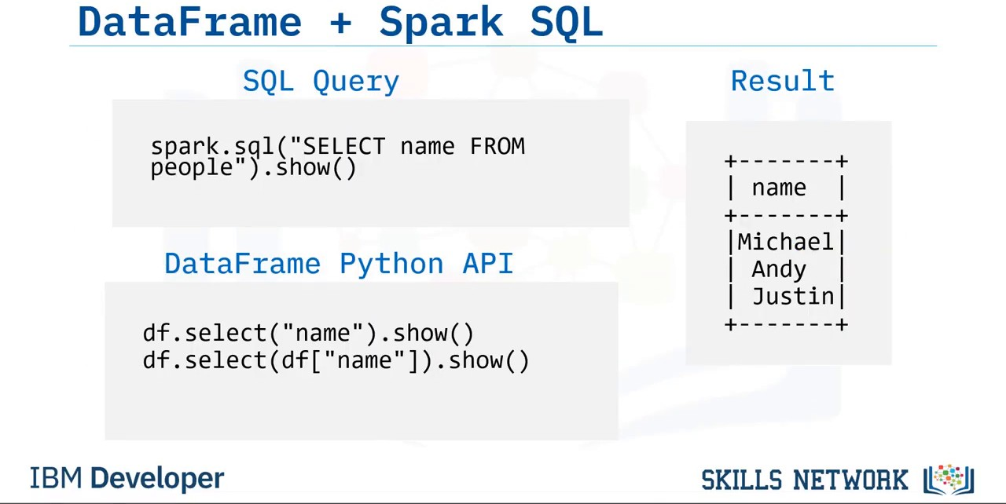

Slide 31
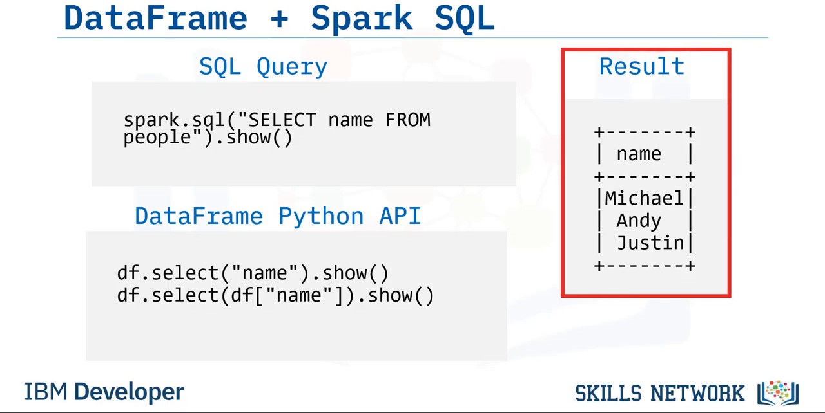

Slide 32
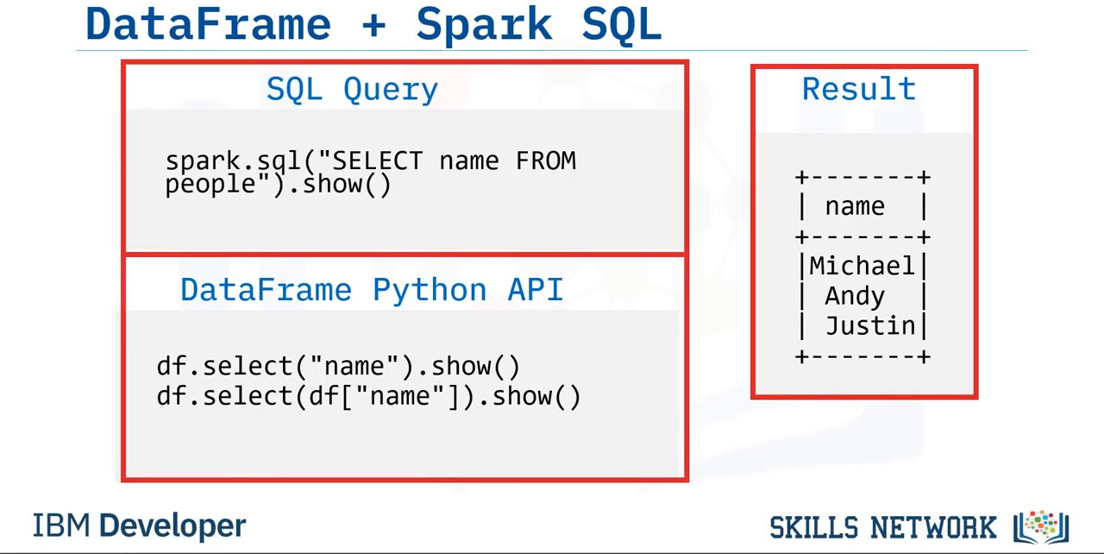

Slide 33
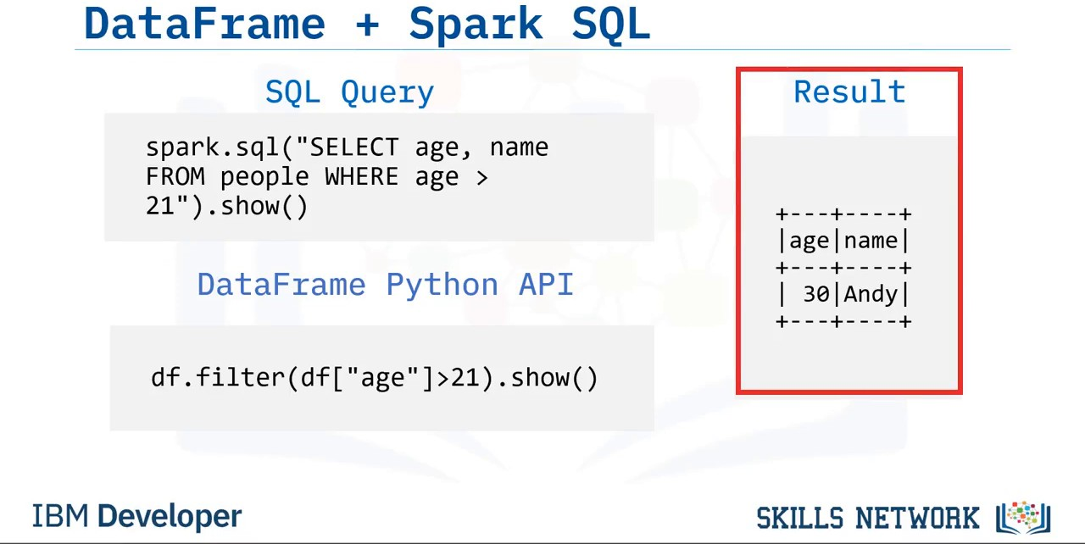

Slide 34
